Slide 1


SCHOLA
Online Classroom Management
A One-Stop solution to manage schedules and lecture materials for students
Notes:
Creadit picture : Unsplash Photo by Chris Yang
Link : https://unsplash.com/photos/1BtAeOohu1A Photo by Vidar Nordli-Mathisen
Link : https://unsplash.com/photos/xqMM3KoR7oI
1

Slide 2





Andromeda
SCHOLA
Our team
We are working with the aim of providing the best software suited to our client’s needs.
Context
Objectives
Features
Technical Requirements
Timeline
Tasnim Ferdous
180041108
Sidratul Muntaha
180041118
Farhan Ishmam
180041120
Contact Us
2
Notes:
Creadit picture : Photo by Anthony Intraversato on Unsplash Link : https://unsplash.com/photos/vYRAP3yMa3I
2

Slide 3

SCHOLA
Our Team
Crisis in Pandemic!
Context
Objectives
Due to the long-term lock-down and continuation of online classes, students face a number of problems which include, but are not limited to:
Problems in finding the correct class links in time
Not receiving notices on quizzes and classes
Juggling multiple online platforms
Different groups receiving unrelated notices
Losing track of current lecture status and quiz syllabus
Not finding shared lecture materials
Features
Technical Requirements
Timeline
Contact Us
3
Notes:
Creadit picture : Photo by Ethan Haddox on Unsplash Link : https://unsplash.com/photos/jvUZkoh4Hhw
3

Slide 4

SCHOLA
Our Team
Client Requirements
Context
Allow Students to keep track of their class links
Send out notices filtered by groups
Allow Class Representatives to manage and send information to students
Allow sharing of class materials and lecture notes
Allow students to make personal notes and/or record their progress in individual courses
Allow access at any time through any platform
Objectives
Features
Technical Requirements
Timeline
Contact Us
4

Slide 5
SCHOLA
Notices
Our Team
Personal lecture Evaluation Sheet
Context
To-do List
Objectives
Individual Class Schedule
Overall Features
Features
Class Test and Exam dates
Technical Requirements
Online-Class Link Address
Timeline
Role Based User Access
Contact Us
5
Notes:
5

Slide 6
SCHOLA
Operating System
Hardware
Our Team
Any as it is a Web-Based Application
Database Server
Website Hosting Server
Context
Objectives
Technical Requirements
Features
Language
Software
Technical Requirements
Java Script (JS)
Hyper Text Markup Language (HTML)
Cascading Style Sheet (CSS)
Structured Query Language (SQL)
Browser
IDE
MySQL
Timeline
Contact Us
6
Notes:
Creadit picture :
Photo by Jordan on Unsplash Link : https://unsplash.com/photos/evtWtv0i-6E
6

Slide 7
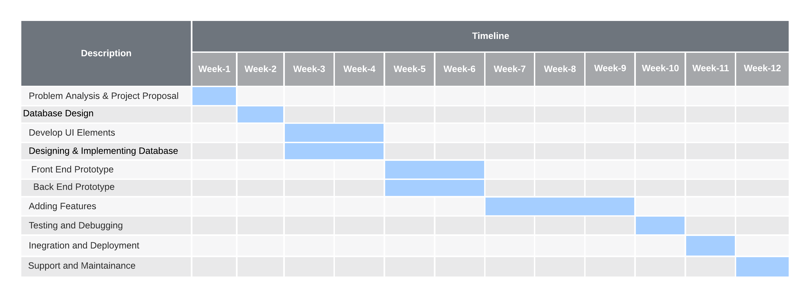
Timeline

Slide 8
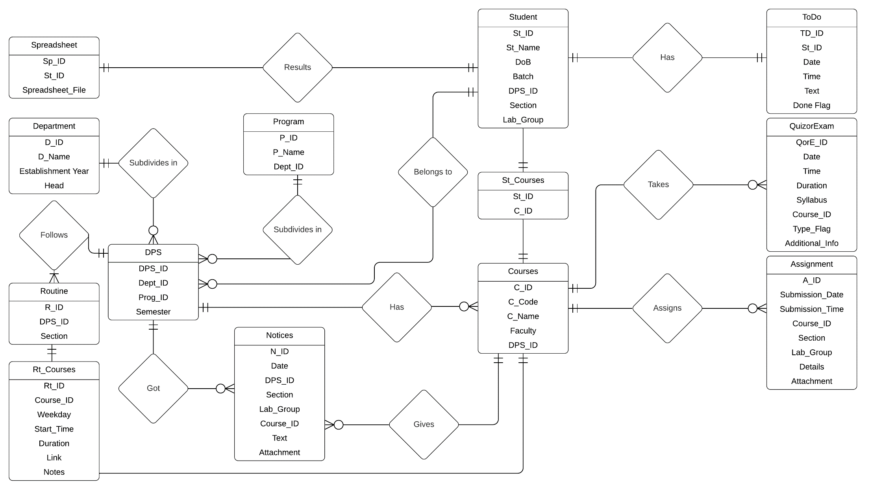
ERD

Slide 9
SCHOLA
Search
Our Team
Contact our Team members
Context
Tasnim Ferdous
+8801703438103
tasnimferdous@iut-dhaka.edu
Objectives
Features
Sidratul Muntaha
+8801742256703
sidratulmuntaha@iut-dhaka.edu
Technical Requirements
Timeline
Farhan Ishmam
+8801745722347
farhanishmam@iut-dhaka.edu
Contact Us
8
Notes:
9

Slide 10
THANK
YOU
Notes:
10

